Slide 1
Building Data WareHouse by Inmon
Chapter 1: Evolution of Decision Support System
Prepared By: Song Nguyen
Date: 05/09/2022

Slide 2
1.1 The Evolution
The need to synchronize data upon update
The complexity of maintaining programs
The complexity of developing new programs
The need for extensive amounts of hardware to support all the master files
Sections
The advent of DASD
PC/4GL Technology
Enter the Extract Program
The Spider Web

Slide 3
1.1.1 The Advent of DASD
1970: Direct Access Storage
DBMS: Data base Management systems
Mid-1970s OLTP: Online Transaction Processing
Goals:
Faster access
Ease of Management

Slide 4
1.1.2 PC/4GL Technology
1980 PC and 4th Generation Language
MIS: Management Information System
DSS: Decision Support System – Single database

Slide 5
1.1.3 Enter the Extract Program

Slide 6
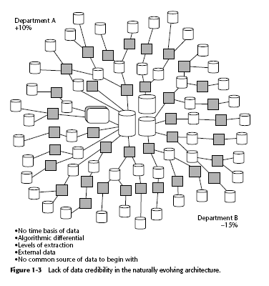
1.1.4 The Spider Web

Slide 8
1.2 Problems with the Naturally Evolving Architect
Lack of Data Credibility
Problems with Productivity
From data to Information
A Change in Approach
The Architected Environment
Data Integration in the Architected Envinronment
Who is the User

Slide 9
1.2.1 Lack of Data Credibility

Slide 10
1.2.1 Lack of Data Credibility (cont)
Natural evolving architecture challenges
Data Credibility
Productivity
Inability to transform data to information
Lack of Data Creditbility
No time basis of data
The Algorithmic differential of data
The Levels of Extraction
The problem of the external data
No common source of data from the beginning

Slide 11
1.2.2 Problems with Productivity
Many files and collections → how to create correct report ?
Locate and analyze the data for report
Compile the data for the report
Get Programmer/analyst resources to accomplish these two tasks.
Complications
Lots of programs have been written
Each Program must be customized
The program cross every technology that the company uses

Slide 12
1.2.2 Problems with Productivity (c)

Slide 13
1.2.2 Problems with Productivity (c)

Slide 14
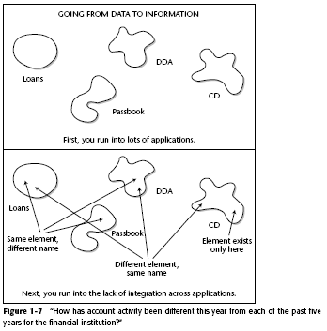
1.2.3 From Data to Information

Slide 15
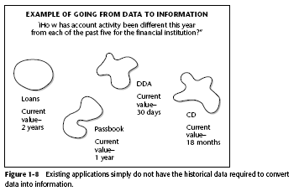
1.2.4 A Change in Approach

Slide 16
1.2.4 A Change In Approach (con’t)

Slide 17
1.2.5 The Architect Environment

Slide 18
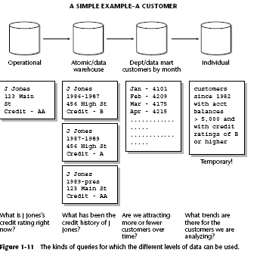
1.2.5.1 A simple Example-A Customer

Slide 19
1.2.6 Data Integration in the Architected Environment

Slide 20
1.2.7 Who Is the Users ?
The attitude of the DSS analyst is important for the following reasons:
It is legitimate. This is simply how DSS analysts think and how they conduct their business.
It is pervasive. DSS analysts around the world think like this.
It has a profound effect on the way the data warehouse is developed and on how systems using the data warehouse are developed.
The classical system development life cycle (SDLC) does not work in the world of the DSS analyst

Slide 21
1.3 The Development Life Cycle

Slide 22
1.4 Patterns of Hardware Utilization

Slide 23
1.5 Setting the Stage for Re-engineering

Slide 24
1.5 Setting the Stage for Re-engineering-c

Slide 25
1.6 Monitoring the Data Warehouse env.
Identifying what growth is occurring, where the growth is occurring, and at what rate the growth is occurring
Identifying what data is being used
Calculating what response time the end user is getting
Determining who is actually using the data warehouse
Specifying how much of the data warehouse end users are using
Pinpointing when the data warehouse is being used
Recognizing how much of the data warehouse is being used
Examining the level of usage of the data warehouse

Slide 26
1.6 Monitoring the Data Warehouse environment con’t
The data profiles that can be created during the data-monitoring process include the following:
A catalog of all tables in the warehouse
A profile of the contents of those tables
A profile of the growth of the tables in the data warehouse
A catalog of the indexes available for entry to the tables
A catalog of the summary tables and the sources for the summary
The need to monitor activity in the data warehouse is illustrated by the following questions:
What data is being accessed?
When?
By whom?
How frequently?
At what level of detail?
What is the response time for the request?
At what point in the day is the request submitted?
How big was the request?
Was the request terminated, or did it end naturally?

Slide 27
Summary
Origin of data warehouse
Architecture that fits data warehouse
Evolution of information processing
Found in Operational environment ends up in the integrated warehouse
System Development Life Cycle paradigm shifts
Decision Support System … Who are the users ?

